Slide 1
Price Variability Analysis of Two Agricultural Products: A 10-Week Comparison
Course Title:Probability and Statistics for Computing
Course Code:MAT 203
Section:D1
Course Teacher:Sharmin Alam

Slide 2
OUR TEAM
GROUP 9
NAME | ID
Asfiqul Alam Emran | 231902049
Al Rezanur Talha | 231902036
Tanveer Ahmed Ziad | 231902048
Promod Chandra Das | 231002005
Naimur Rahman Sheetal | 231902006

Slide 3
Contents
Introduction
Tasks
Data collection
Methodology
Infographics
Code
Conclusion

Slide 4
INTRODUCTION
This presentation examines the 10-week price trends of onions and potatoes. We’ll compare their price variability using statistical measures like mean, median, mode, standard deviation, and mean deviation to determine which product experienced greater fluctuation.

Slide 5

Tasks
Collect two product’s 10-week price (per kg).
Example: Week-1: onion-52, potato-22
Week-2: onion-48, potato-23
Then prepare frequency distribution table for each of the products and compare the followings:
Mean, Median and mode of the prices
Standard deviation and Mean deviation of the prices of each of the products
Which product has more variability of prices and why?
?
?
?

Slide 6
DATA COLLECTION

Slide 7
Collected Data
Week | Onion (per kg) | Potato (per kg)
Week 1 | 52 | 22
Week 2 | 48 | 25
Week 3 | 52 | 27
Week 4 | 54 | 30
Week 5 | 56 | 28
Week 6 | 58 | 30
Week 7 | 55 | 35
Week 8 | 53 | 38
Week 9 | 50 | 36
Week 10 | 51 | 40

Slide 8
Frequency Distribution Table
Onions
Potatoes
Class interval: 2
Class interval: 4
Class Interval | tally | Frequency
- 50 | || | 2
50 - 52 | ||| | 3
52 - 54 | || | 2
54 - 56 | || | 2
56 - 58 | | | 1
Class Interval | Tally | Frequency
22 - 26 | || | 2
26 - 30 | |||| | 4
30 - 34 |  | 0
34 - 38 | ||| | 3
38 - 42 | | | 1

Slide 9
Tables to calculate mean, Median and Mode
Class Interval | Frequency (Fi) | Mid value(xi) | Cumulative Frequency | fixi
- 50 | 2 | 49 | 2 | 98
50 - 52 | 3 | 51 | 5 | 153
52 - 54 | 2 | 53 | 7 | 106
54 - 56 | 2 | 55 | 9 | 110
56 - 58 | 1 | 57 | 10 | 57
Total=524
Class Interval | Frequency (fi) | Mid value(xi) | Cumulative Frequency | fixi
22 - 26 | 2 | 24 | 2 | 48
26 - 30 | 4 | 28 | 6 | 112
30 - 34 | 0 | 32 | 6 | 0
34 - 38 | 3 | 36 | 9 | 108
38 - 42 | 1 | 40 | 10 | 40
Total=308

Slide 10
METHODOLOGY

Slide 11


Mean
Onions
Potatoes
${\overline{x}}_{0}$= $\frac{ \sum{fixi}}{N}$
${\overline{x}}_{p}$= $\frac{ \sum{fixi}}{N}$
Mean = 52.4
Mean = 30.8

Slide 12

Median
Median = $l+ \frac{h}{f_{m}}$ ($\frac{N}{2}$ - c)
Onions
Potatoes
Median class is ( 50 – 52 )
Median class is ( 26 – 30 )
l = 50
h = 2
fm = 3
N = 10
C = 2
l = 26
h = 4
fm = 4
N = 10
C = 2
Median = 52
Median = 29

Slide 13

Mode
Mode = l + $\frac{f1}{f1+f2} × h$
Onions
Potatoes
Mode class is ( 50 – 52 )
Mode class is ( 26 – 30 )
l = 50
f1 = 1
f2 = 1
h = 2
l = 26
f1 = 2
f2 = 4
h = 4
Mode = 51
Mode = 27.33

Slide 14
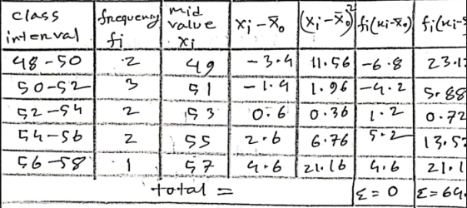
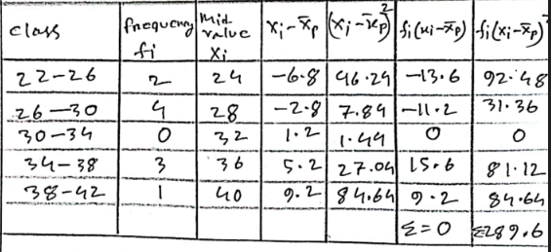
Table for Mean deviation and Standard deviation
Onion
Potato

Slide 15
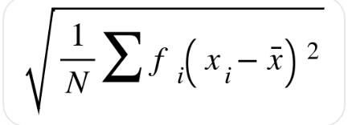
Standard Deviation
The Equation:
Onions Standard Deviation = 2.53
Potatoes Standard Deviation = 5.38

Slide 16
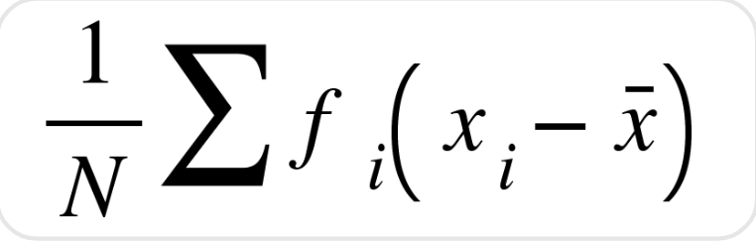
Mean Deviation
The Equation:
Onions Mean Deviation = 0
Potatoes Mean Deviation = 0

Slide 17
Which product has more variability of prices and why?
We can see from the column chart that,
Potato has more price variability compared to onion.
Calculated Variability:
Onion: 6.4009
Potato: 28.9444
Reason: The higher standard deviation and mean deviation of potato prices indicate greater fluctuations over the 10-week period. This suggests that external factors such as supply, demand, or seasonal effects may have caused more instability in the price of potatoes compared to onions.

Slide 18

INFOGRAPHICS
Price

Slide 19
Comparison of the Mean, Median and Mode of the prices

Slide 20
Comparison of Standard Deviation and Mean Deviation
5.38
2.53
0
0

Slide 21
Variability of Prices
28.94444
6.4009

Slide 22
Key Insights

Slide 23
CODE
fprintf('\nPotato Prices:\n');
fprintf('Mean: %.2f, Variance: %.2f, Standard Deviation: %.2f,
Mean Deviation: %.2f\n', ...
mean_potato, variance_potato, std_dev_potato,
mean_deviation_potato);
% Plotting the prices
figure;
hold on;
plot(weeks, onion_prices, '-o', 'DisplayName', 'Onion Prices',
'LineWidth', 2);
plot(weeks, potato_prices, '-o', 'DisplayName', 'Potato Prices',
'LineWidth', 2);
hold off;
% Graph formatting
title('Price Comparison of Onions and Potatoes Over 10
Weeks');
xlabel('Weeks');
ylabel('Price (per kg)');
legend('show');
grid on;
Onion Prices:
Mean: 52.90, Variance: 8.77, Standard Deviation: 2.96, Mean
Deviation: 2.30
Potato Prices:
Mean: 31.10, Variance: 34.99, Standard Deviation: 5.92, Mean
Deviation: 4.92
>>
>> % Price data for onions and potatoes over 10 weeks
weeks = 1:10;
onion_prices = [52, 48, 52, 54, 56, 58, 55, 53, 50, 51];
potato_prices = [22,25,27,30,28,30,35,38,36,40];
% Calculate statistics for onions
mean_onion = mean(onion_prices);
variance_onion = var(onion_prices);
std_dev_onion = std(onion_prices);
mean_deviation_onion = mean(abs(onion_prices -
mean_onion));
% Calculate statistics for potatoes
mean_potato = mean(potato_prices);
variance_potato = var(potato_prices);
std_dev_potato = std(potato_prices);
mean_deviation_potato = mean(abs(potato_prices -
mean_potato));
% Display the results
fprintf('Onion Prices:\n');
fprintf('Mean: %.2f, Variance: %.2f, Standard Deviation: %.2f,
Mean Deviation: %.2f\n', ...
mean_onion, variance_onion, std_dev_onion,
mean_deviation_onion);

Slide 24
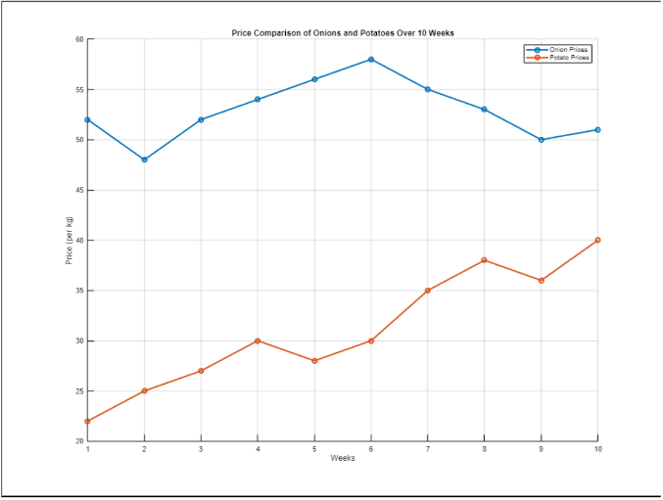
MATLAB OUTPUT

Slide 25
CONCLUSION
This analysis of onion and potato prices over 10 weeks revealed that:
Onions had a mean price of 52.4 and a standard deviation of 2.53, indicating relatively stable prices.
Potatoes had a mean price of 30.8 and a higher standard deviation of 5.38, reflecting greater price variability.
In summary, while onion prices were stable, potato prices fluctuated more significantly, likely due to market demand and supply factors.

Slide 26
THANK
YOU

